Slide 1


Slide 2
DEPT. OF ELECTRICAL & ELECTRONICS ENGINEERING
TECHNOLOGY-DRIVEN
BUSINESS
How Technology Creates Value, Improves Decisions, & Reshapes Modern Enterprises
NSIT - NETAJI SUBHAS INSTITUTE OF TECHNOLOGY
Amhara, Bihta, Patna • B.Tech Class Presentation | Semester 1, Academic Year 2026

Slide 3
Meet the Student Presenters
RAJNISH
Roll No: 264002
Research & Core Content
Synthesizing market trends, strategic frameworks, and tech business logic.
RISHU
Roll No: 264006
EEE Technical Foundation
Bridging hardware telemetry, smart grid signals, and embedded electronics.
TUSHAR
Roll No: 264011
Business Case & Models
Analyzing SaaS monetization, platform dynamics, and unit economics.
HIMANSHU
Roll No: 264012
Presentation & Strategy
Designing slide visual hierarchy, architectural workflows, and storytelling.

Slide 4
What Is a Tech-Driven Business?
Core Concept: A technology-driven business leverages digital infrastructure, continuous telemetry data, and automated algorithms to solve customer friction and generate scalable, high-margin value.
1. Connectivity
High-speed cloud infrastructure and IoT sensor networks linking global markets, equipment telemetry, and active users seamlessly.
2. Data Analytics
Converting raw telemetry data into actionable intelligence, enabling real-time demand forecasting and hyper-personalized user value.
3. Automation
Replacing manual operational bottlenecks with deterministic software algorithms, cloud microservices, and industrial robotics.
4. Digital Trust
Robust cybersecurity protocols protecting system identity, safeguarding sensitive consumer data, and guaranteeing operational uptime.

Slide 5
Modern Business Models
SaaS (Software as a Service)
Subscription-based cloud platforms delivering continuous value, software updates, and central data management without high upfront client infrastructure costs.
Examples: Enterprise ERP, CAD modeling suites, Cloud Analytics.
Two-Sided Digital Platforms
ESystems connecting buyer and seller networks efficiently, dramatically lowering search costs, matching friction, and transaction fees through algorithms.
Examples: B2B component exchanges, App ecosystems.
Direct-to-Consumer (D2C)
Direct consumer engagement powered by dedicated applications, custom digital checkout experiences, and algorithmic loyalty systems.
Examples: Brand apps, subscription commerce.
Telemetry Data Monetization
Monetizing real-time operational telemetry, predictive maintenance alerts, and automated decision support systems derived from embedded hardware.
Examples: IoT fleet telemetry, Smart Grid diagnostics.

Slide 6
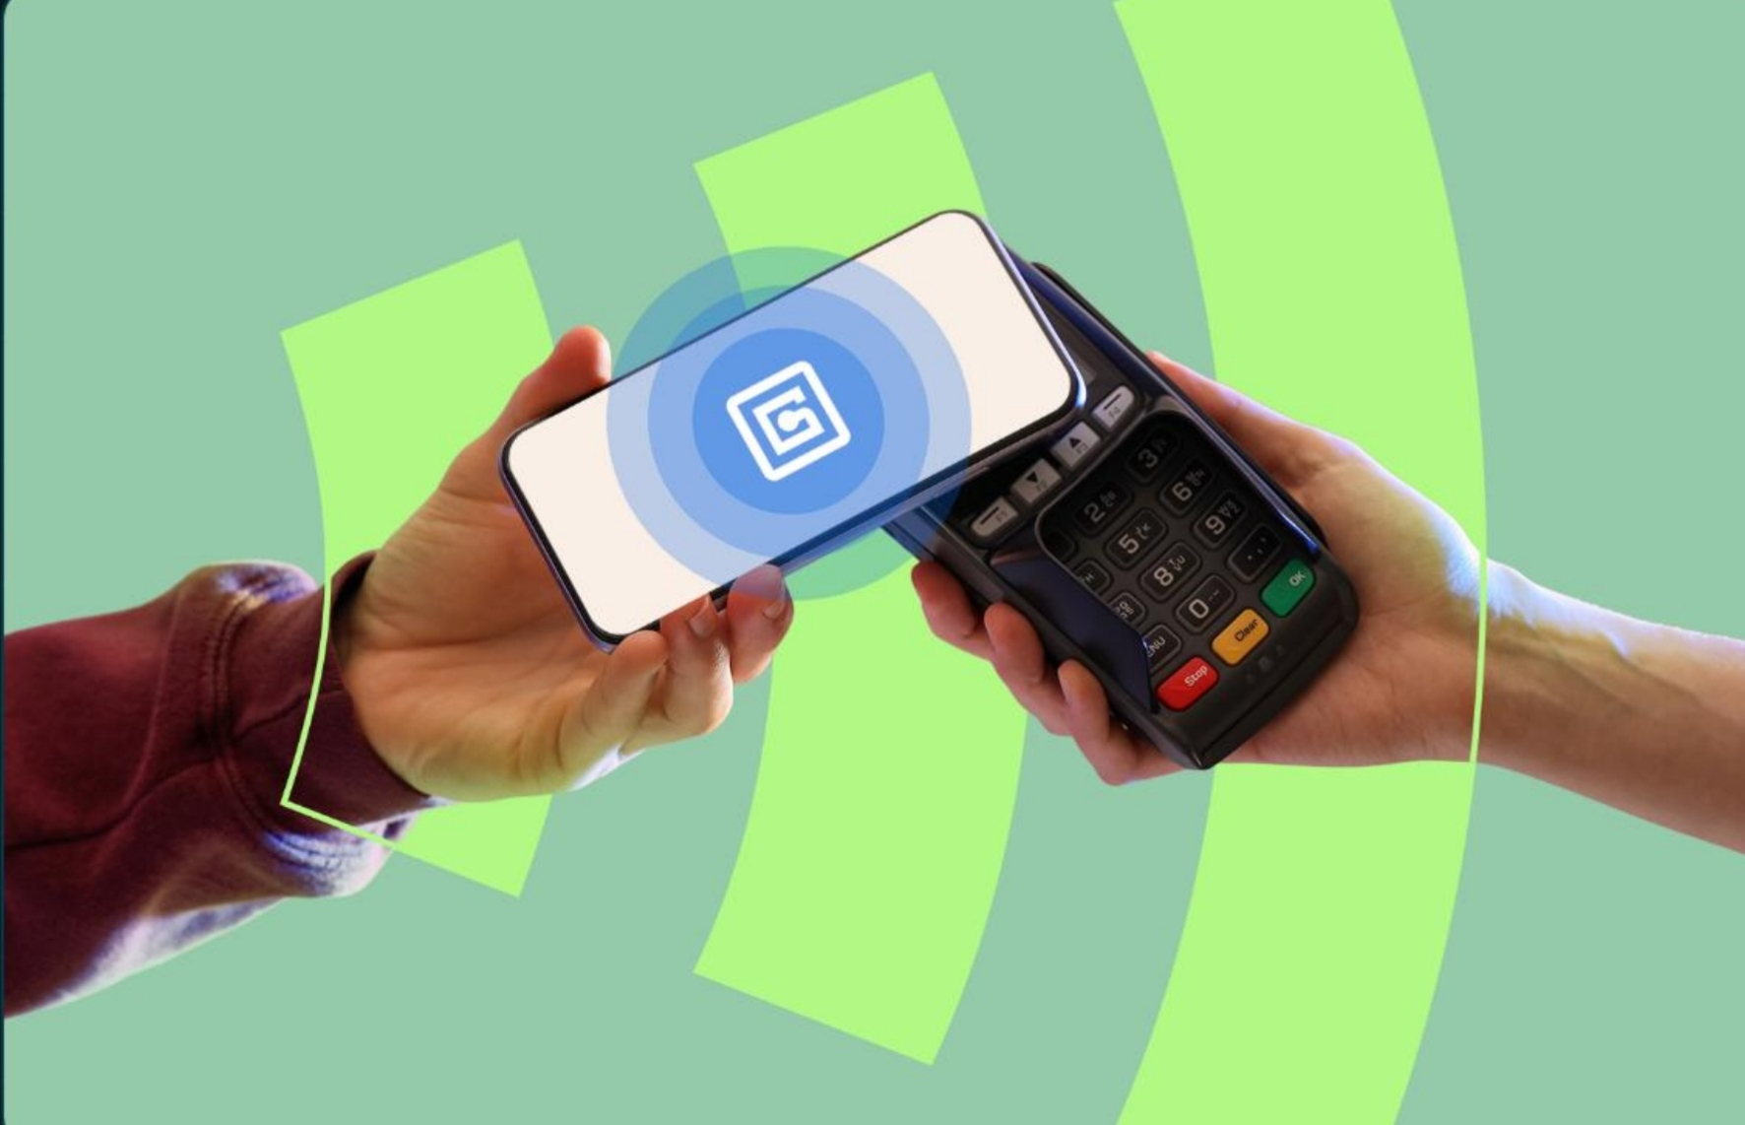
SEAMLESS MICRO-FRICTION TRANSACTIONS ($17.25 EXAMPLE)
Case Study: Digital Payments
1. User Touchpoint
Customer initiates instant transaction via smartphone mobile wallet or contactless NFC terminal.
2. Cloud Network Gateway
Encrypted payment gateways authenticate security tokens and execute authorization in under 200ms.
3. Data & Fraud AI
Real-time neural networks evaluate geographic and transaction anomalies to block fraud instantly.

Slide 7

Modern Enterprise Tech Stack
✓ AI & Machine Learning: Automates pattern recognition, predictive customer behavior, and dynamic pricing algorithms.
✓ Cloud & Edge Infrastructure: Delivers elastic, low-latency compute power and global database synchronization.
✓ IoT & Sensor Arrays: Bridges physical hardware and cloud databases by collecting continuous telemetry.
✓ Cybersecurity & Identity: Protects operational integrity, prevents unauthorized network breaches, and ensures privacy.
✓ Embedded Hardware Controllers: Executes low-level signal processing directly at the physical machine boundary.

Slide 8
HOW ELECTRICAL & ELECTRONICS ENGINEERING BUILDS THE HARDWARE FOUNDATIONAL LAYERS BEHIND MODERN BUSINESS TECH.
Connection with EEE Discipline
Smart Energy Grids
Power electronics, digital metering, and wireless telemetry optimizing renewable energy distribution and load management.
Industrial Automation
Programmable logic controllers (PLCs), microcontrollers, and actuators powering continuous high-throughput manufacturing.
Electric Mobility (EV)
High-voltage power converters, intelligent battery management systems (BMS), and connected charging grid networks.

Slide 9
Benefits vs. Operational Challenges
Strategic Dimension | Enterprise Growth Opportunity | Engineering & Operational Challenge
Speed & Scale | Instant global market expansion and near-zero incremental distribution cost. | High upfront capital investment in cloud infrastructure and tech talent.
Customer Value | Hyper-personalized user experiences powered by real-time behavioral data. | Escalating cybersecurity threats, zero-day vulnerabilities, and data privacy rules.
Operations | Automated workflows with minimal human error and higher operational throughput. | High dependency on cloud service providers and hardware single-point failures.
Decision Making | Data-backed predictive insights replacing gut-feeling managerial estimates. | Managing algorithmic bias, data quality issues, and legacy system integration.

Slide 10
Building a Tech-Driven Enterprise
01
Problem Discovery
Identify genuine human, operational, or market friction points that require technology.
02
Test Solution
Build and validate a lean Minimum Viable Product (MVP) with core functional features.
03
Embed Telemetry
Integrate IoT sensors and tracking metrics to capture real user and hardware usage data.
04
Scale System
Deploy elastic cloud auto-scaling and automated software release pipelines.
05
Iterate Fast
Continuously upgrade hardware firmware and cloud software based on live analytics.

Slide 11
Key Strategic Takeaways
100%
Synergy of Hardware & Software
Modern business models depend equally on high-speed low-latency electronics, cloud infrastructure, and predictive analytics.
✓ Strategic Engine: Technology is not merely a support tool—it is the core catalyst for value creation, business models, and competitive edge.
✓ Pillar Integration: Cloud connectivity, sensor data, software automation, and security must work together seamlessly.
✓ The EEE Hardware Bridge: Electrical & Electronics Engineering builds the physical sensors, power converters, and microcontrollers.
"The goal is not to use more technology. The goal is to create more meaningful value."

Slide 12
NETAJI SUBHAS INSTITUTE OF TECHNOLOGY
THANK YOU!
Questions & Open Discussion
Presenters
Rajnish (264002) • Rishu (264006) • Tushar (264011) • Himanshu (264012)
Department of Electrical & Electronics Engineering (EEE) | Amhara, Bihta, Patna

